Slide 1

CSE 3224 Information System Design and Software Engineering Lab
Teacher-Student Collaboration system

Slide 2
Group members
Mahir Rashid : 15-01-04-011
Tasnim Mashrur Mahee : 15-01-04-013
Atiqul Islam Chowdhury : 15-01-04-014
Md. Saiful Islam : 15-01-04-027

Slide 3
Data Flow Diagram
Graphical representation of the flow of data through an information System
Shows what kind of information will be input to and output from the system
Illustrates where data comes from, where it goes and how it gets stored in an information System

Slide 4
Types of data flow diagram
Context Level Diagram
Level 0 Diagram
Level 1 Diagram

Slide 5
Main process
Process 1.0 : Course Process
Process 2.0 : Quiz Process
Process 3.0 : Attendance Process
Process 4.0 : Materials Process
Process 5.0 : Data Accumulation

Slide 6
DB names
D1 : Course
D2 : Quiz
D3 : Attendance
D4 : Materials
D5 : Teacher
D6 : Student
D7 : Individual Data

Slide 7
Context level diagram
High level view of System
Represents all external entities that may interact with a system
Shows the relationship that the system has with other external entities

Slide 8
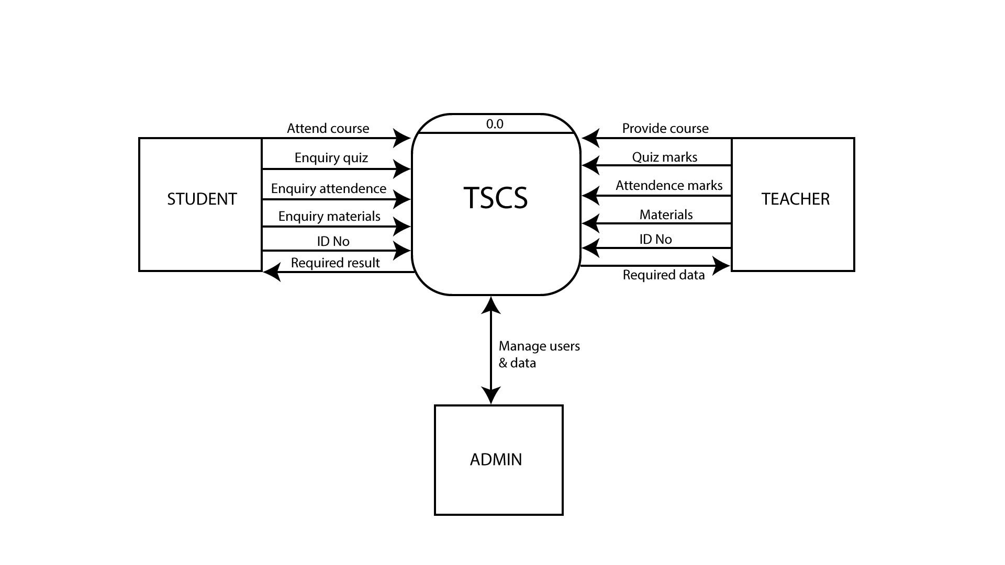
Context level diagram

Slide 9
Level 0 diagram
Provides a more detailed breakout of pieces of the Context Level Diagram
Highlights the main functions carried out by the system

Slide 10
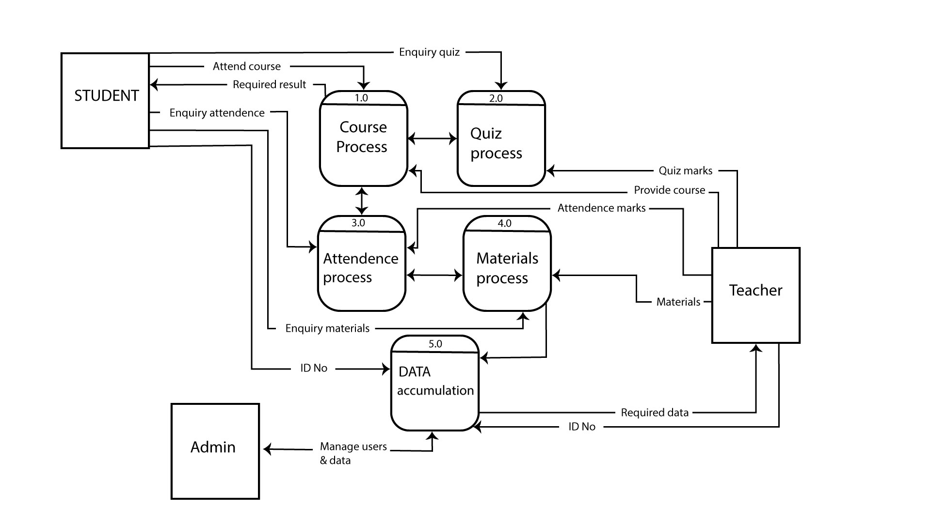
Level 0 diagram

Slide 11
Level 1 diagram
Diagram of sub systems of Level 0
Details about the system functioning

Slide 12
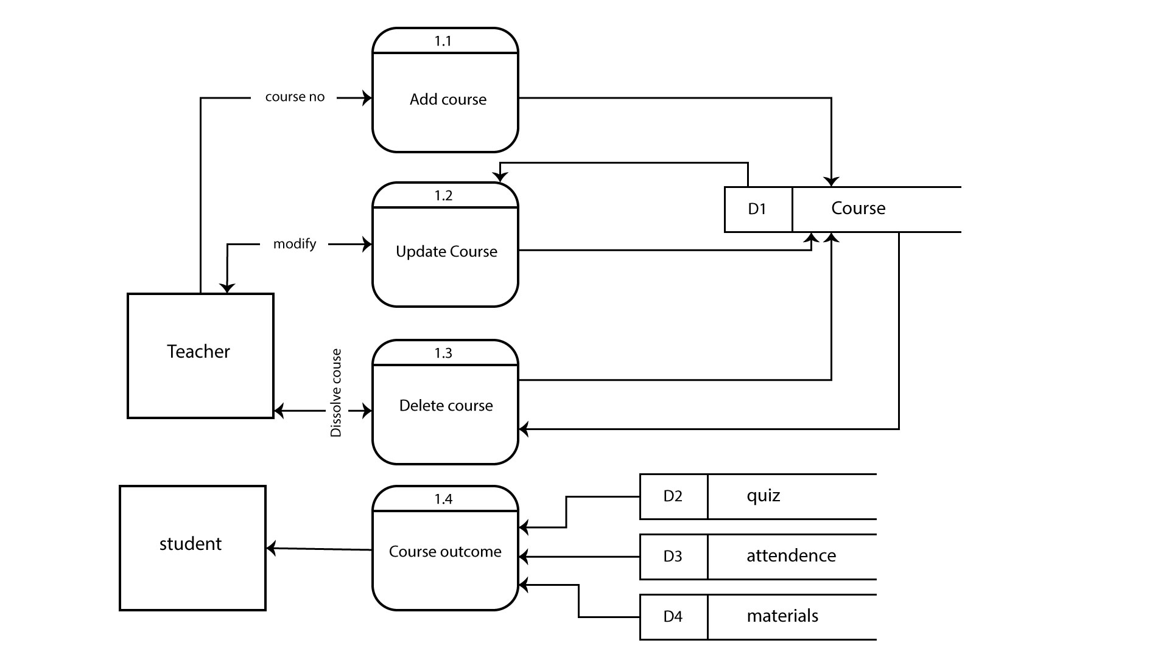
Level 1: course process

Slide 13
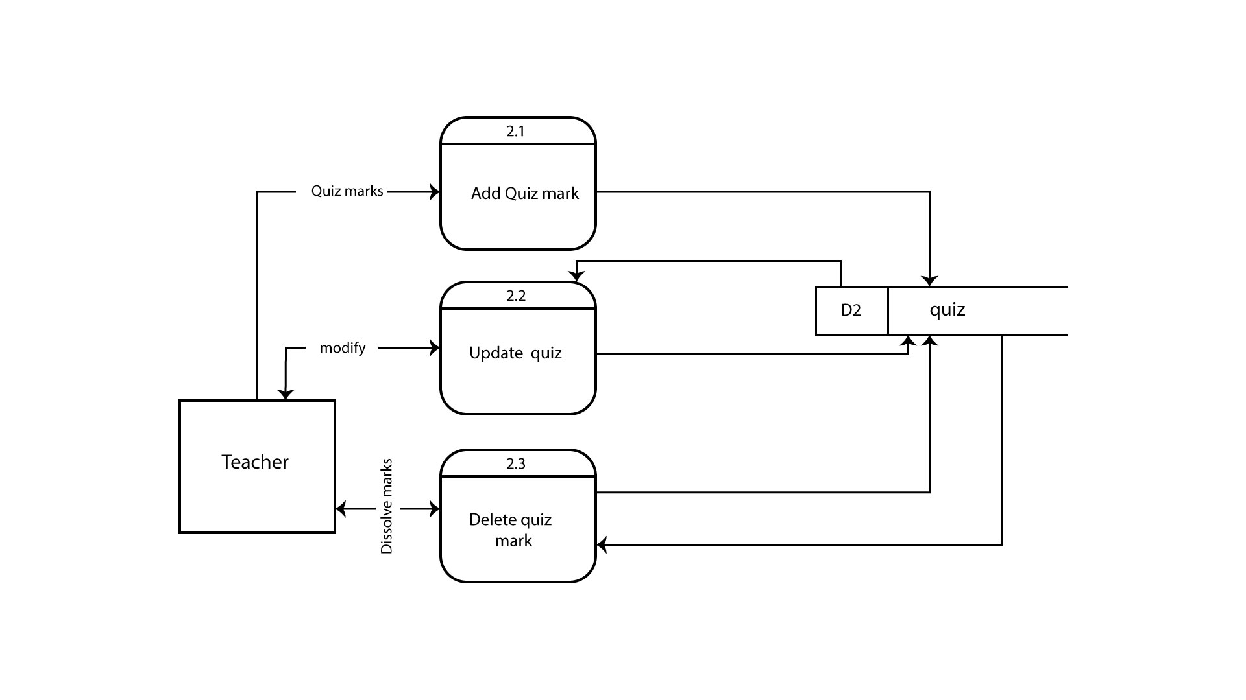
Level 1: quiz process

Slide 14
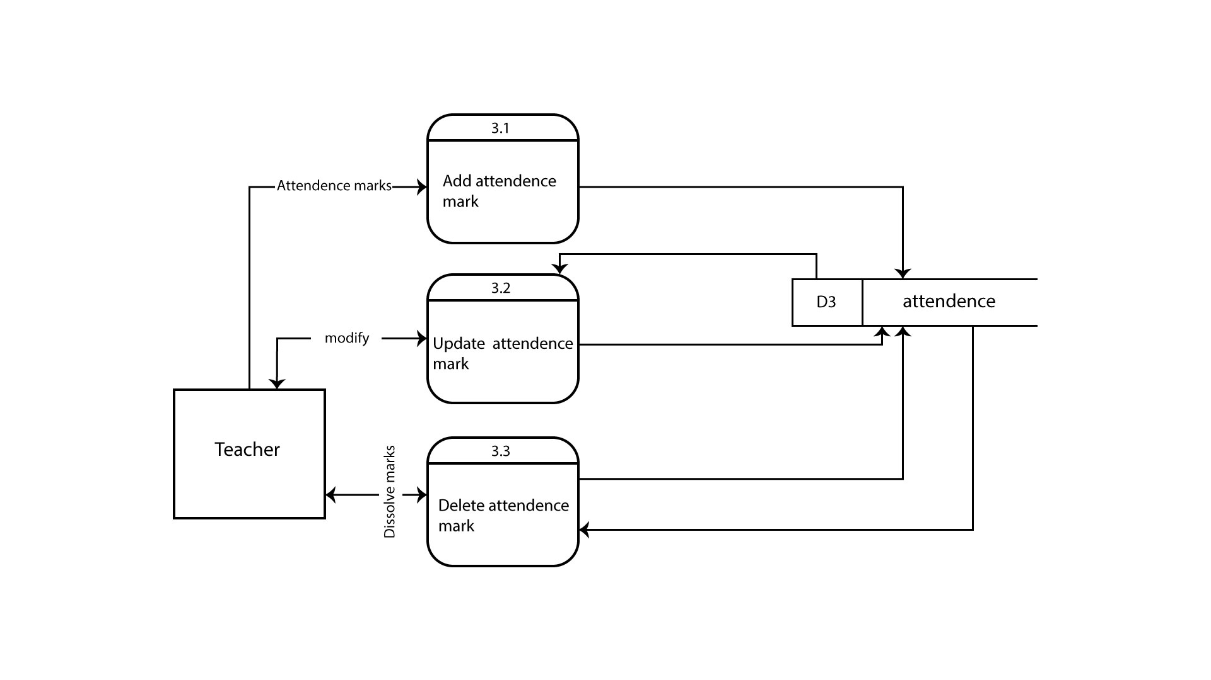
Level 1: attendance process

Slide 15
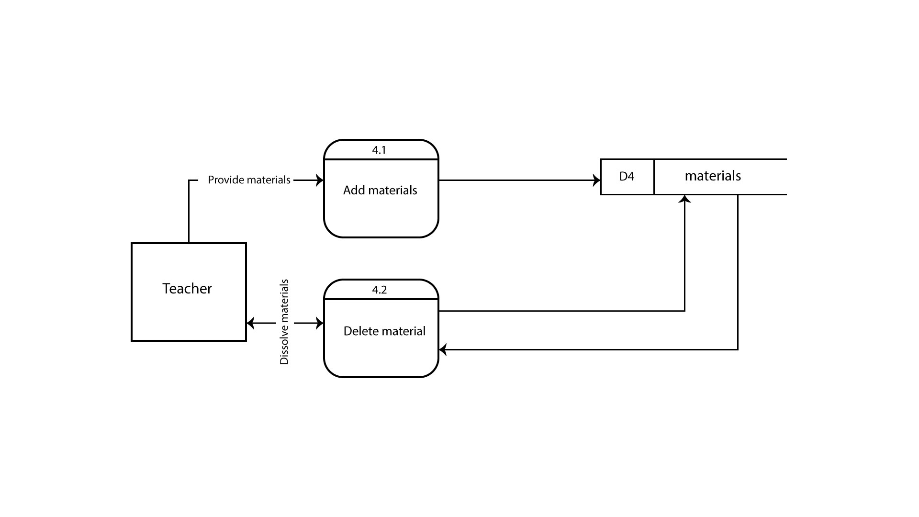
Level 1: materials process

Slide 16
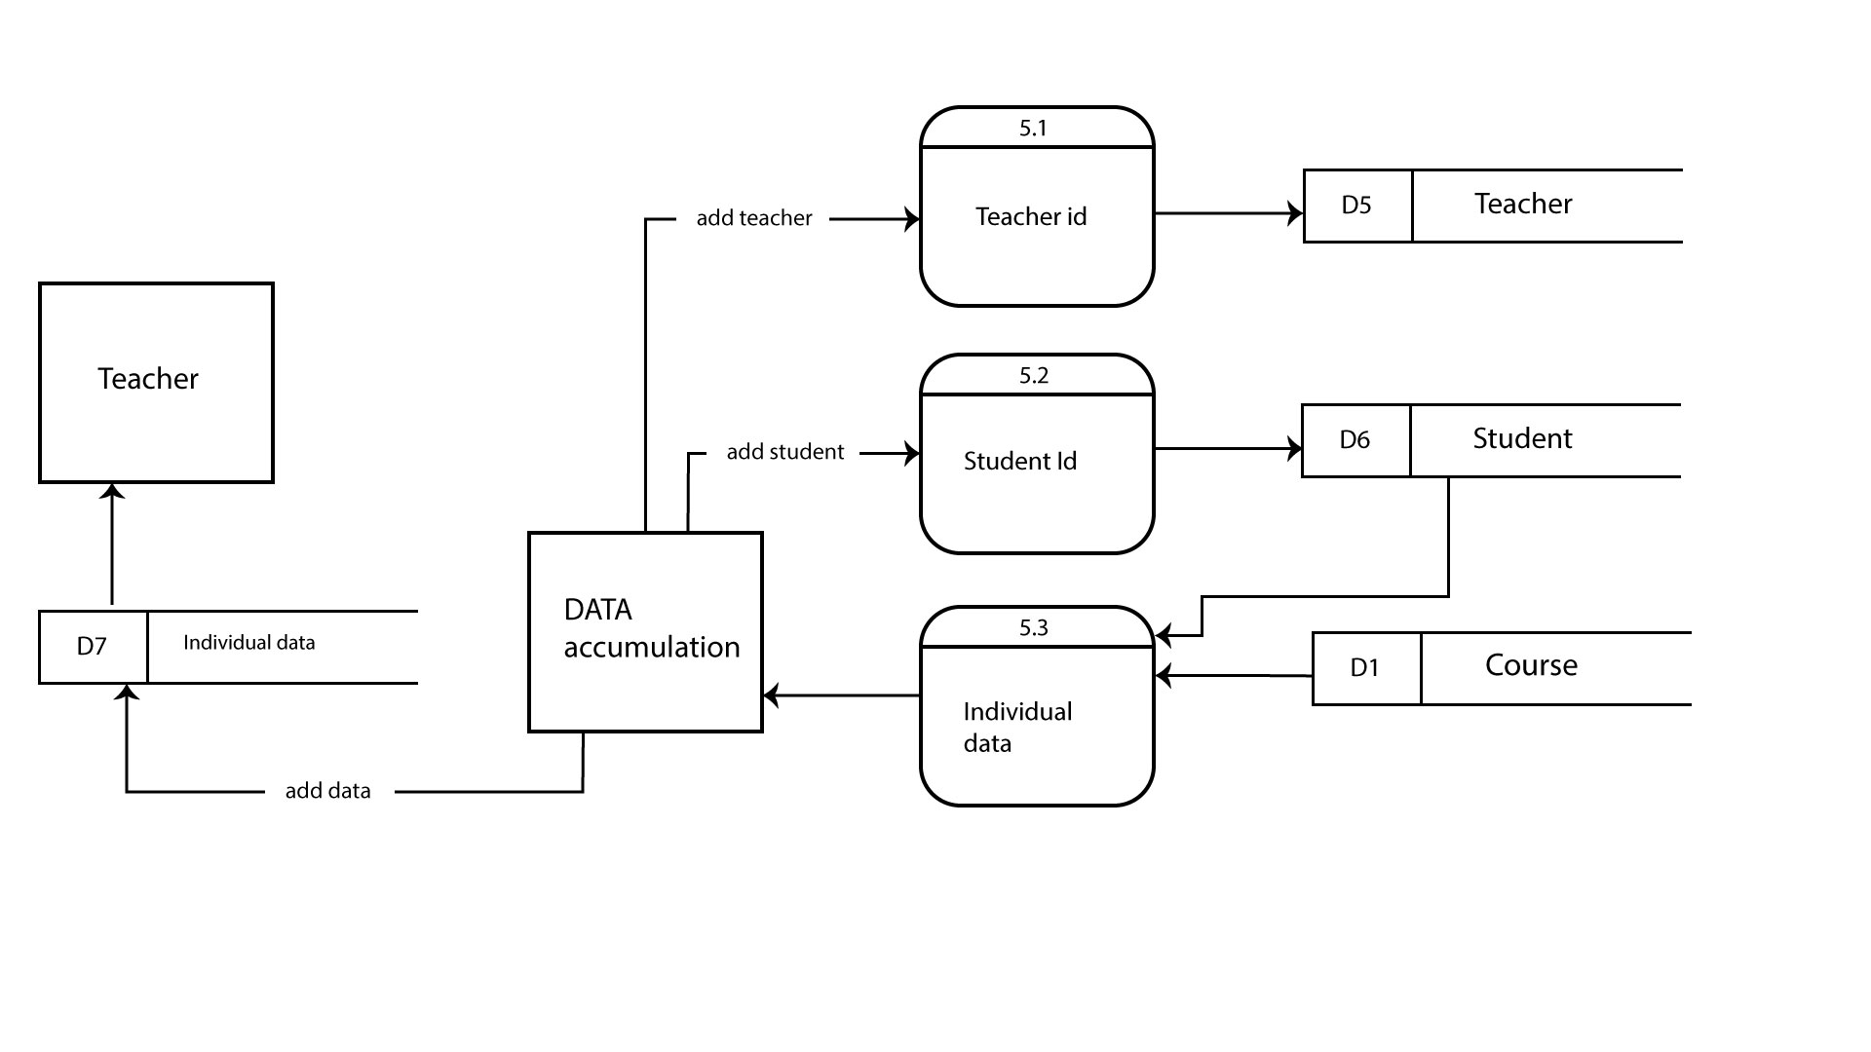
Level 1: data accumulation

Slide 17
Use case diagram

Slide 18
actors
Admin
Teacher
Student

Slide 19
Functions of actors
Admin :
- Can manage users and control the system
- Check the data stores in database
Teacher :
- Can create course, add, delete, update marks of quiz and attendance and provide materials to the system
Student :
- Can take course, get marks of quiz and attendance and get materials and other information from the system

Slide 20
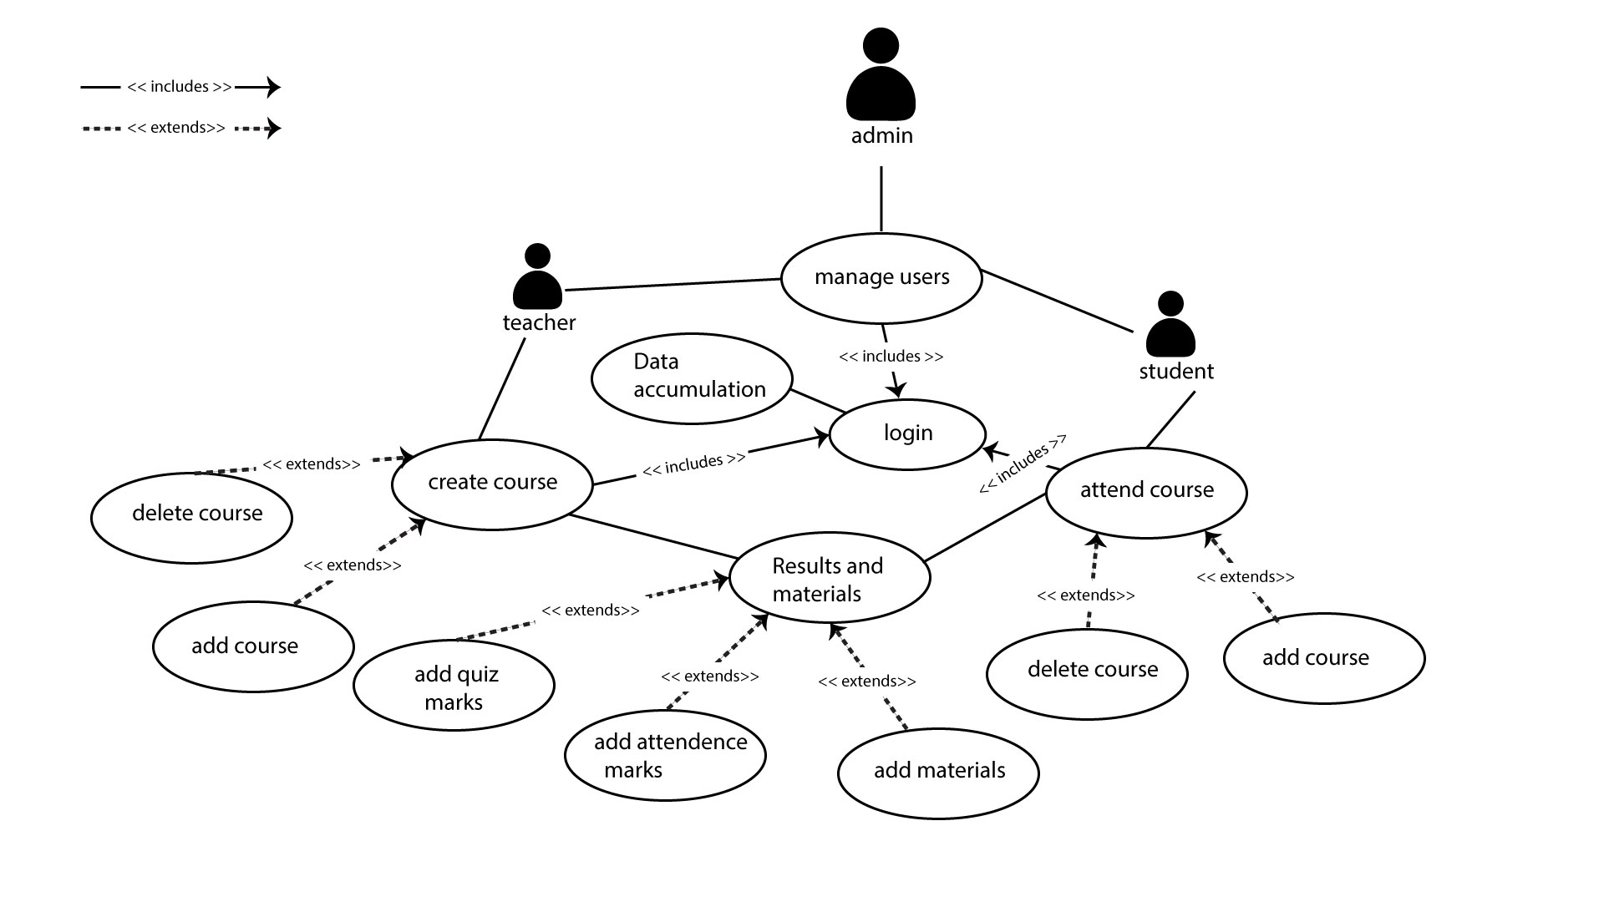
Use case diagram

Slide 21
Thank you any question??

